Slide 1
Individual Assistance
Streamlined Registration Intake
& Individual Assistance Reforms
May 2023

Slide 2
Streamlined Registration Intake

Slide 3
Why Streamline Registration?
  Improve survivor experience and reducing applicant burden during a traumatic and difficult part of their lives;
  Tailoring registration intake in a logical way strengthens confidence in the federal government and manages survivor expectations;
  A simpler, more intuitive application process allows applicants to select their specific needs;
  FEMA anticipates a 15%+ reduction in registration time for disaster survivors based on these changes.

Slide 4
Background - Registration Intake
The President declares a major disaster and approves Individual Assistance on a county basis, relying on joint FEMA/State damage assessments
FEMA activates registration intake for survivors affected by the disaster
Registration intake involves an application to determine eligibility and receive certain forms of financial and direct assistance
FEMA offers this service through multiple modes:
  Call-center (1-800-621-3362)
  In-person with Disaster Survivor Assistance Teams or by visiting a Disaster Recovery Center
  Self-service at DisasterAssistance.gov

Slide 5
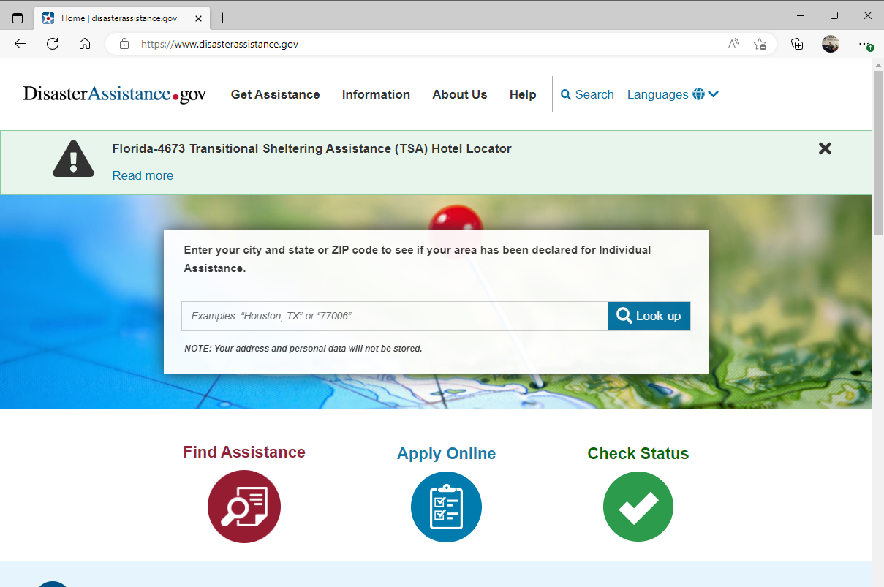
Previous Registration Intake
Splash Page

Slide 6
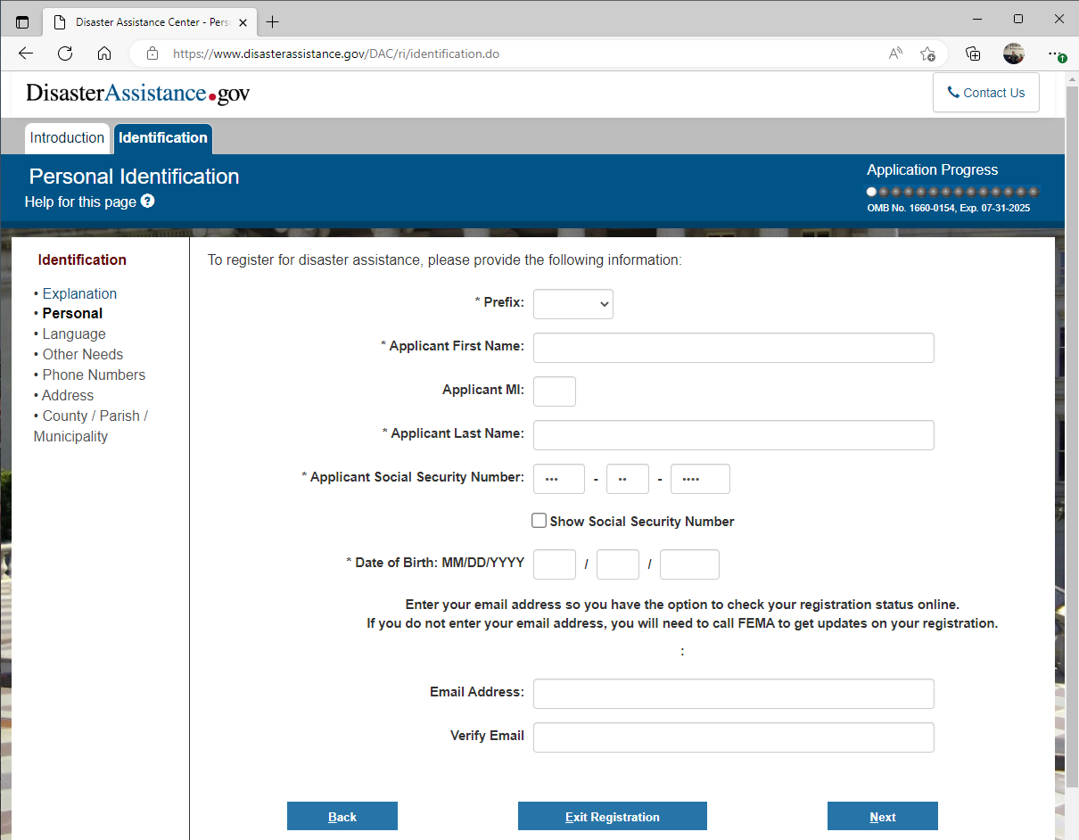
Previous Registration Intake
Personal Information Collection
After privacy and burden pages, all survivors regardless of need or eligibility are directed to fill out an application

Slide 7
Previous Registration Intake
Splash Page
Application progress (gray dots) shows 12 more sections
Each section has several pages to enter information

Slide 8
Changes between Previous and Streamlined Registration Intake
Previous RI
Streamlined RI
Linear question flow
Every survivor completes application regardless of needs
Survivors can’t determine position in application and what comes next
Logical, branching question flow
Survivor identifies need first, then answers appropriate questions
Easier navigation
Integrated with Login.gov

Slide 9
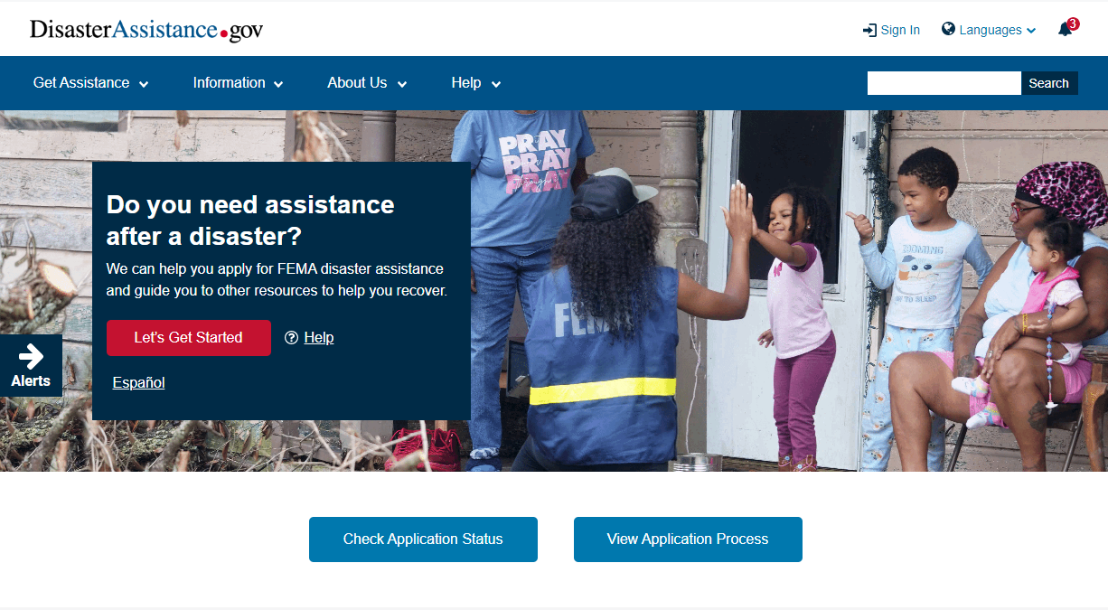
Streamlined Registration Intake
Splash Page
Notes:
Mock up of the streamline RI splash page. You can see it’s very obvious for a survivor to apply for assistance.

Slide 10
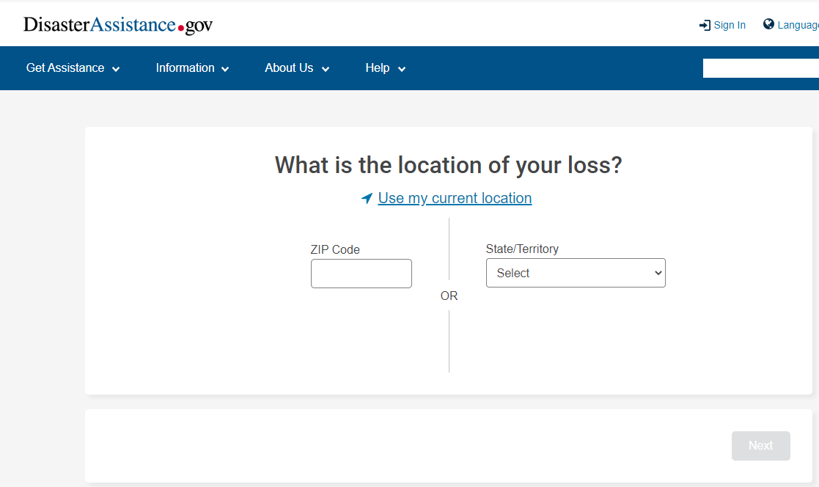
Streamlined Registration Intake
Location Filter
The location page lets us identify survivors who have no active disasters declared for Individual Assistance in their area and redirect them to other resources.

Slide 11
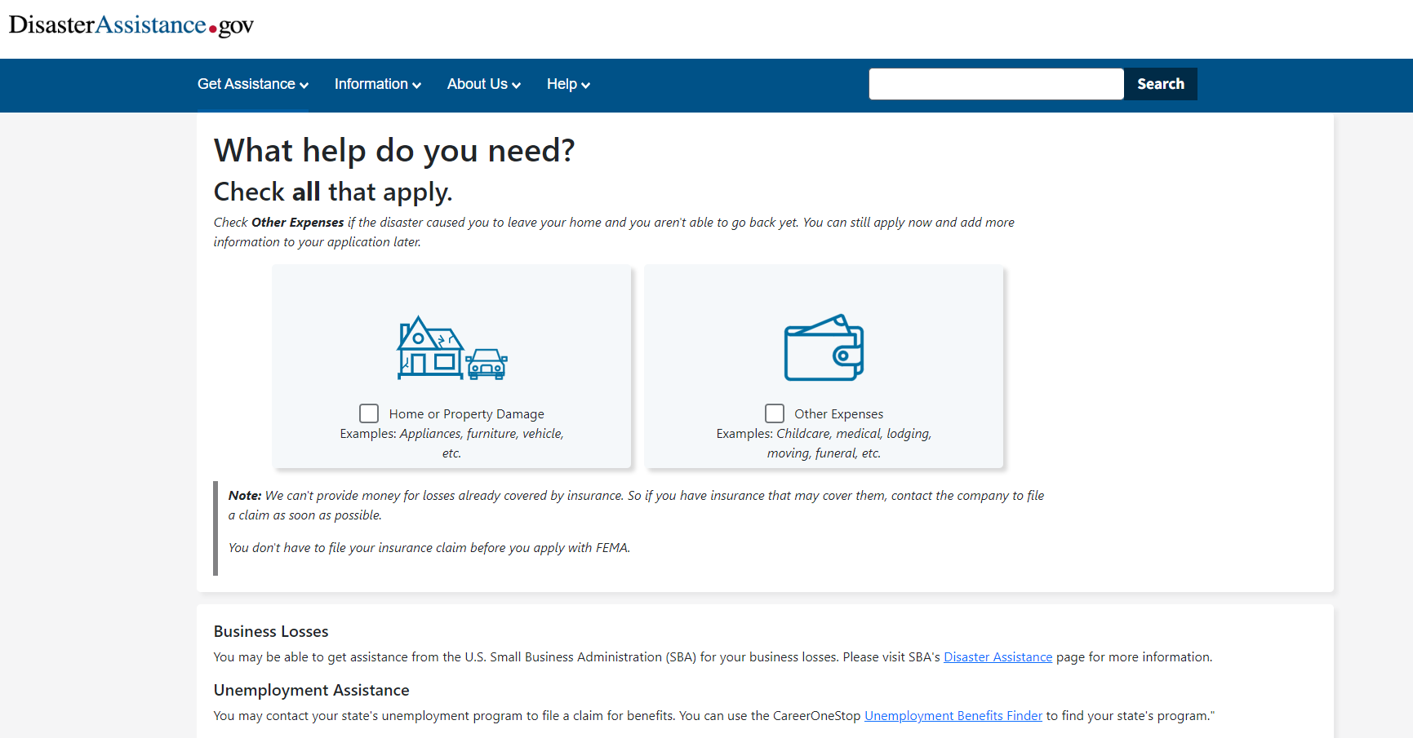
Streamlined Registration Intake
Initial Needs Assessment

Slide 12
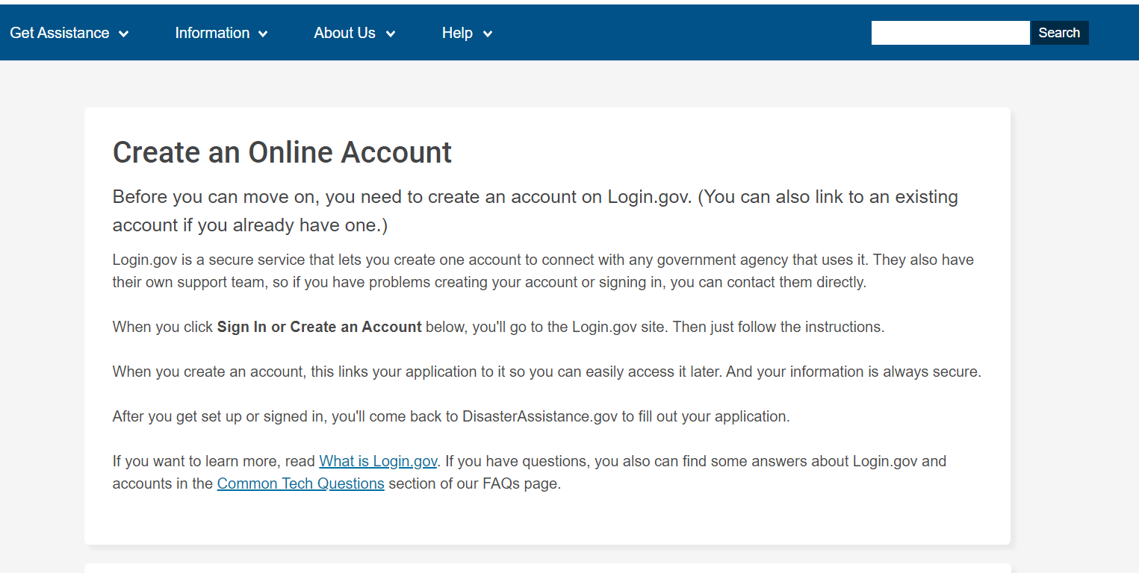
Streamlined Registration Intake
Online account description
This forwards applicant to sign in or create an account at Login.gov.

Slide 13
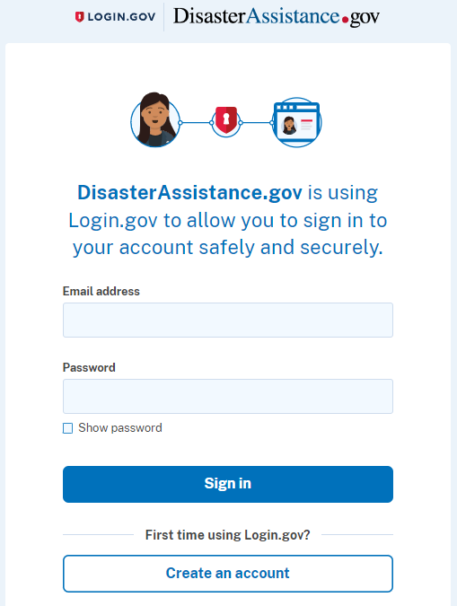
Login.gov Integration
Registration Intake
Login.gov
Streamline RI: Login.gov will be required for all online applicants.
  Auto populates email address within application form
  Common username/password across government
  Identity verification and authentication for added security and trust
Current RI: recently integrated login.gov at the end of the application, which is optional

Slide 14
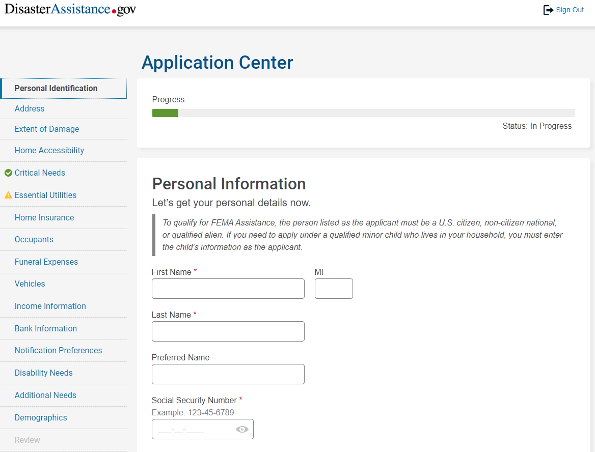
Streamlined Registration Intake
Application Start
FEMA has now established the survivor is potentially eligible for disaster assistance, and will ask for specific personal information pertaining to their specific needs

Slide 15
Individual Assistance Reforms

Slide 16
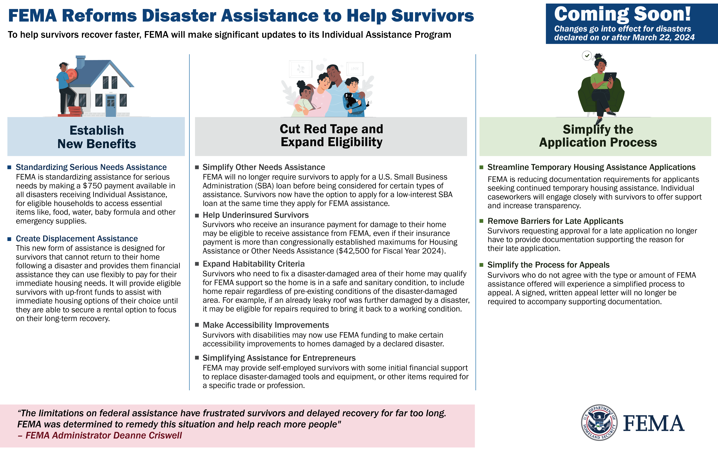
IA Reforms Help Survivors Recover Faster
Establish benefits that provide flexible funding directly to survivors when they need it most.
Establishing Serious Needs Assistance
  Now available in all disasters receiving IA
  The payment of $750 per household with serious needs
Establishing Displacement Assistance
  Provide eligible survivors with up-front assistance for immediate housing options

Slide 17
Reforms Help Survivors Recover Faster and Stronger
Cuts red tape and expands eligibility to reach more people
  Removing loan application requirements
  Helping underinsured survivors
  Simplifying assistance for entrepreneurs
  Expanding habitability criteria
  Making accessibility improvements

Slide 18
Reforms Simplify Application Process
Application process is simplified to meet survivors’ individual needs and meet people where they are.
  Removes barriers for late applicants
    No longer provide documentation
  Streamlines temporary housing assistance
    Reducing documentation required
  Simplifies the process for appeals
    No longer provide written appeal letter

Slide 19
Questions

Slide 20
Angele Rogers
FEMA Region VI
Individual Assistance Branch Director
225-910-5251 angele.rogers@fema.dhs.gov

